Slide 1
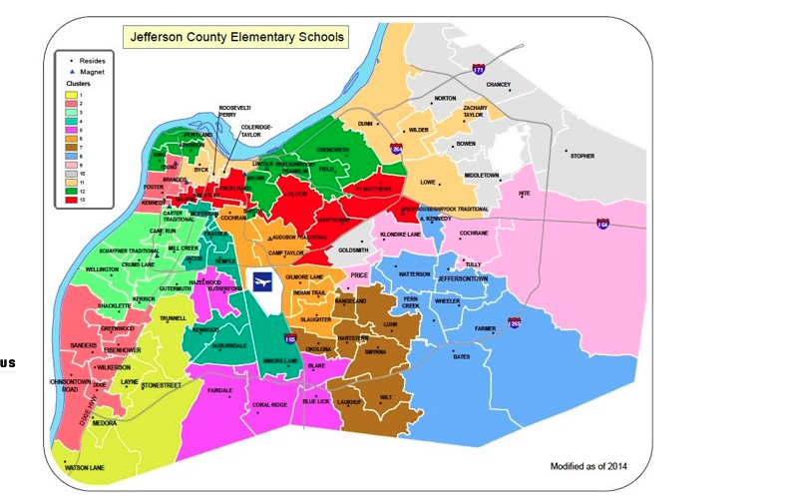
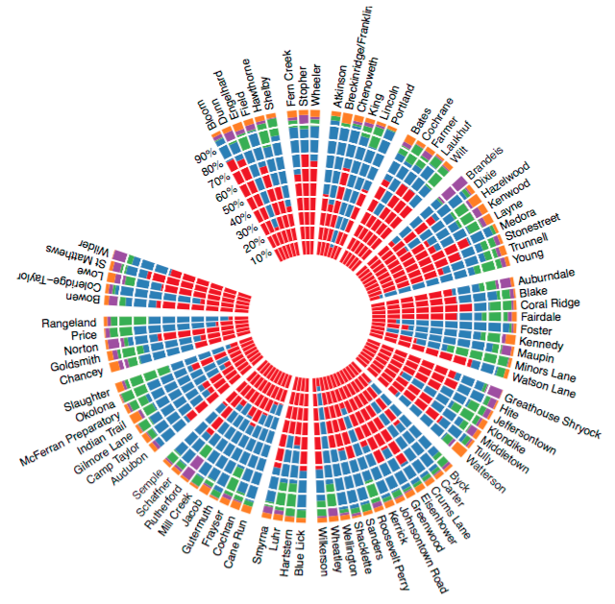
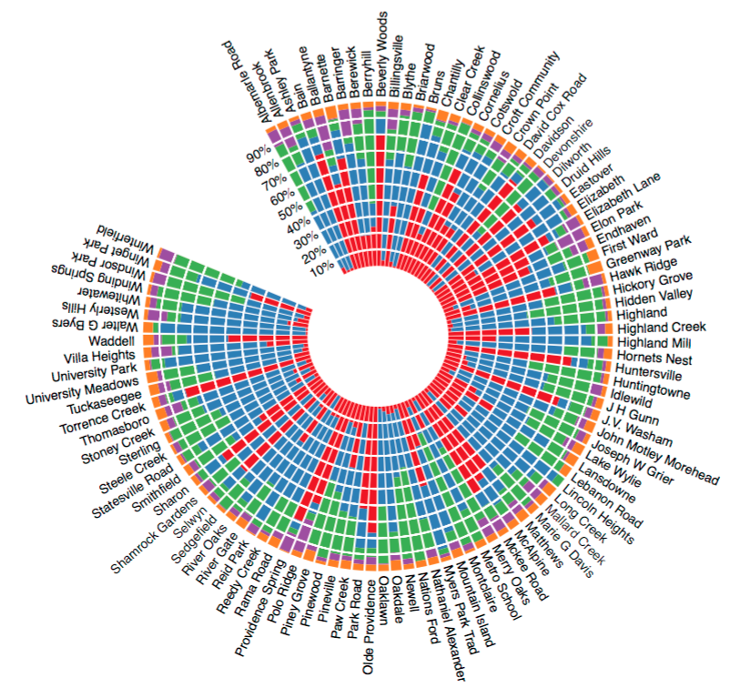
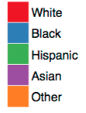
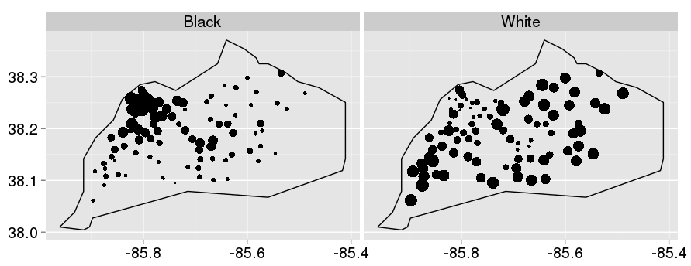

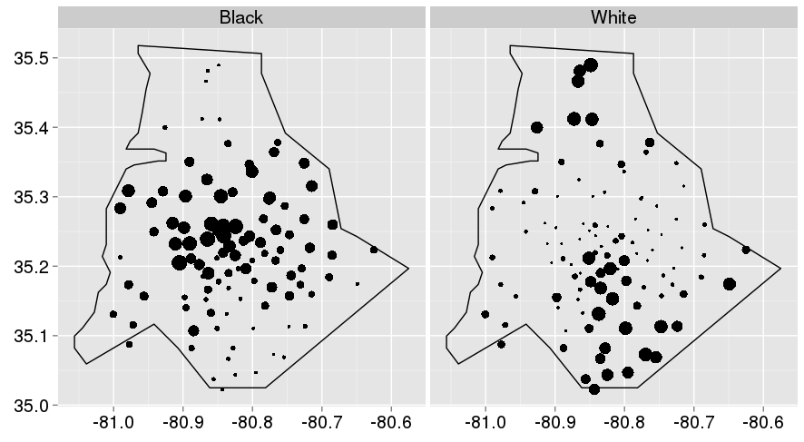

School Assignment Policies and Race:
A Comparison of Jefferson County and Mecklenburg County School Districts
Data Science for the Public Good
Jessica Flynn (Cornell University), Madison Arnsbarger (Virginia Tech), with Kathryn Schaefer Ziemer (SDAL)
Research Questions
Motivation
Given that Jefferson County has a school assignment integration plan, can a difference in the racial distribution of students in schools be noted when compared to Mecklenburg County?
  Is the plan working to achieve its goals of desegregation?
    Are Jefferson County schools more racially integrated?
  Can the integration be demonstrated spatially?
Although segregation was deemed unconstitutional more than 50 years ago, many schools across the country remain segregated due to policies in counties and states (1).
Students in segregated schools are often deprived of the positive outcomes associated with integrated school settings (2):
  better critical thinking,
  communication,
  social skills, and
  lack of poverty.
Policy Review
Jefferson County
1975: Kentucky Board of Education mandates a race-based busing system to promote desegregation.
2007: Meredith vs. Jefferson County Public School : Deemed unconstitutional to integrate schools solely on the basis of race. A new plan that aspires to create integrated clusters on the basis of income, family education level, and percent whiteness was developed and is currently in place.
Jefferson County Elementary School Clusters (3)
Mecklenburg County
1971 Swann vs. Charlotte-Mecklenburg Board of Education: The Supreme Court’s first metropolitan wide desegregation decision.
2002: Racial based integration ended. Public schools began to re-segregate and have remained so to present times. Students are assigned to schools solely based on geographic location.
Data and Method
Mecklenburg County Elementary School Assignments (4)
Statewide Longitudinal Data Systems (SLDS)
Kentucky and North Carolina
  Jefferson and Mecklenburg Counties
Academic Year Fall 2013
Elementary public school grades 3-5
  88 in Jefferson County
  103 in Mecklenburg County
Racial Breakdowns by Elementary School
Race
Descriptive Analysis
Polar histograms depict the racial breakdown, as a percentage, for the Jefferson County and Mecklenburg County school districts. Each bar on the charts represents an individual elementary school within the respective county.
  In the Jefferson County chart, the schools are grouped into the 13 clusters that the school assignment plan denotes.
Spatial correlation graphs display the proportions of White and Black students. Each point represents a school in its respective county, and the size of the point aids in visualizing the proportions.
Jefferson County
Jefferson County
Mecklenburg County
Latitude
Proportion
Discussion
A comparison of the polar histograms shows that Jefferson County schools appear to be more integrated than Mecklenburg County Schools.
  Percentages of each racial group remain relatively consistent across schools.
Jefferson County schools are less likely to be dominated by a single racial group, whereas in Mecklenburg County, minority-majority schools are frequent.
The spatial graphs show that in both counties, where Whites are prevalent, Blacks are sparse and vice versa.
  In Jefferson County, the city of Louisville schools are largely populated with minorities, while the outer suburbs are populated by whites.
  A similar effect is observed in Mecklenburg schools near the city of Charlotte.
In conclusion, the Jefferson County integration plan has not fully broken down racial segregation in schools, especially in urban areas, and a more comprehensive policy must be created to do so.
Longitude
Mecklenburg County
Latitude
Proportion
Longitude
References
Siegel-Hawley, G. P. (2011). City lines, county lines, color lines: An analysis of school and housing segregation patterns in four southern metropolitan areas, 1990-2010
Orfield, G., Frankenberg, E., Ee, J., & Kuscera, J. (2014, May 25). Brown at 60: Great Progress, a Long Retreat and an Uncertain Future. Civil Rights Project.
Semuels, A. (2015, March 27). Louisville Gave Desegregation a Try. The Atlantic. Retrieved from http://www.theatlantic.com/business/archive/2015/03/the-city-that-believed-in-desegregation/388532/
CMS. (2016). County-wide Elementary School Map. Retrieved from http://www.cms.k12.nc.us/cmsdepartments/StudentPlacement/Documents/Elem_bdy_1516_.pdf
bi.vt.edu/sdal

